Slide 1

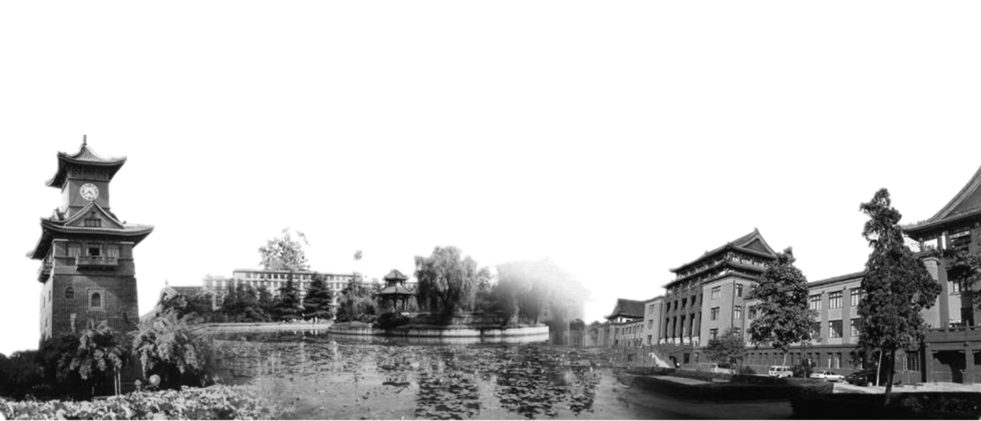

You Only Look Once:
Unified, Real-Time Object Detection

Slide 2

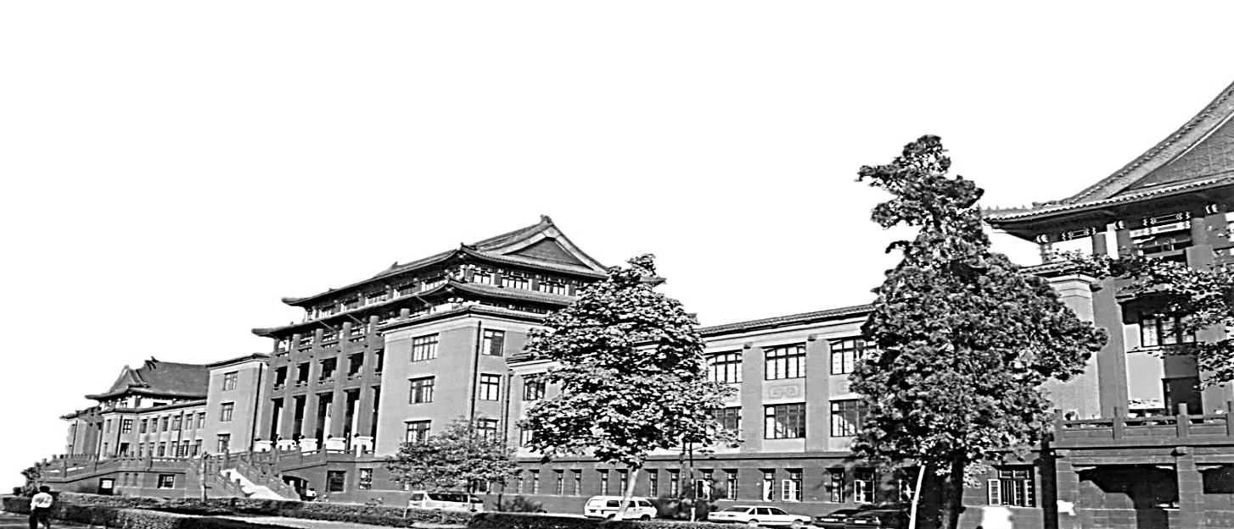
Contents
01
Pipeline
02
Experiments
Comparison
03
04
Summary

Slide 3

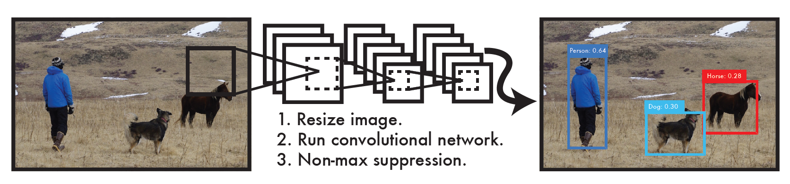
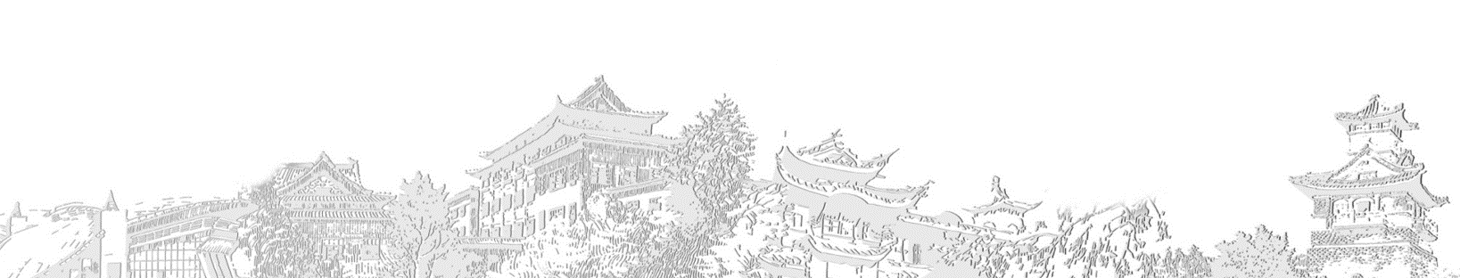

1. Pipeline
In all
Resize the input images to 448*448
Run a single convolutional network on the image
Thresholds the resulting detections by model’s confidence.

Slide 4
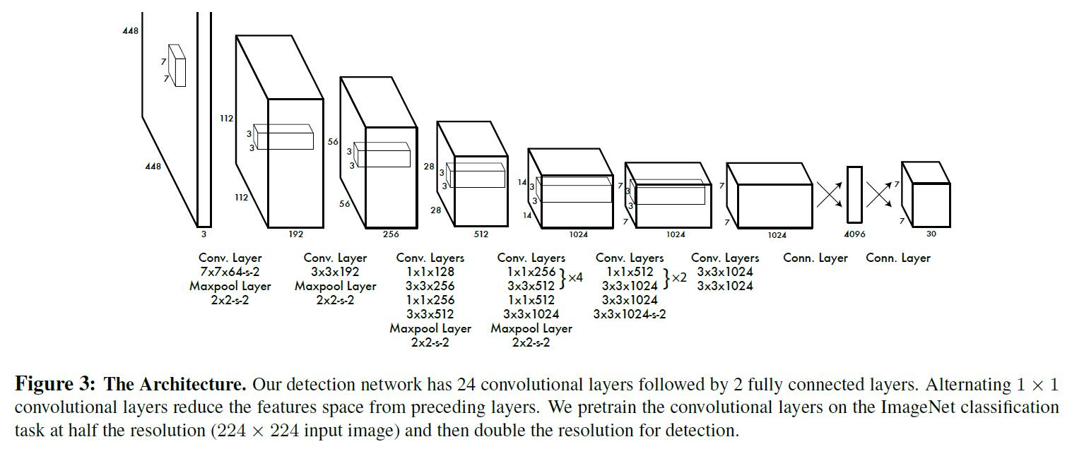
1. Pipeline
Network Design
The network architecture, inspired by the GoogleNet model for image classification, has 24 convolutional layers followed by 2 fully connected layers.

Slide 5
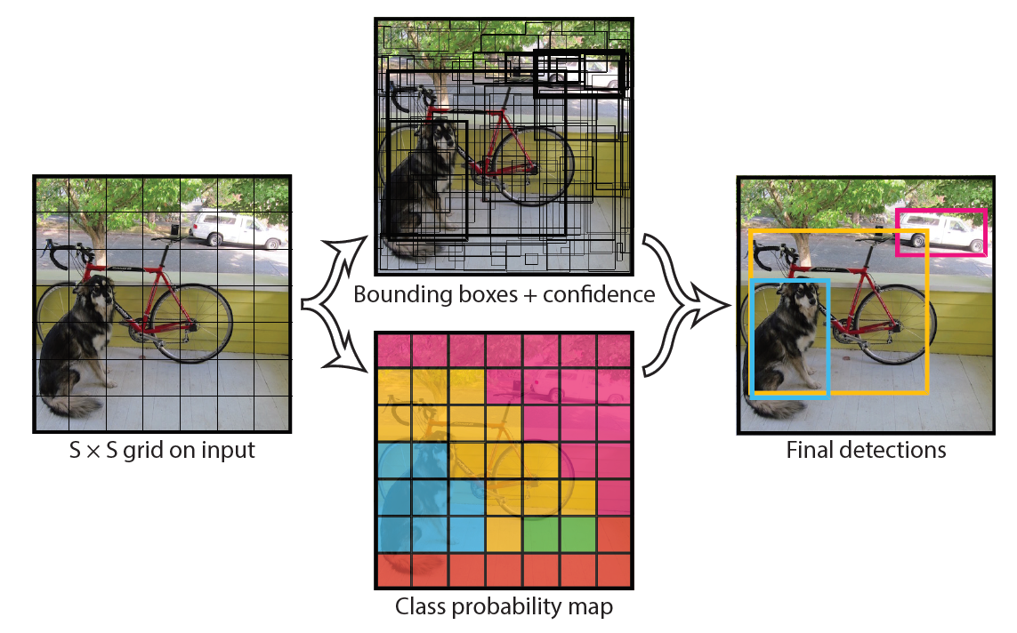
1. Pipeline
Unified Detection
Unify the separate components of object detection into a single neural network
Use features from the entire image to predict each bounding box
Predict all bounding boxes across all classes for an image.

Slide 6
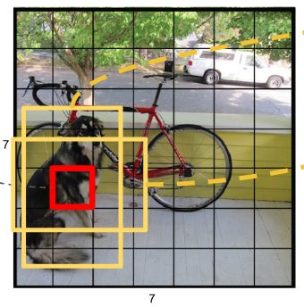
1. Pipeline
Unified Detection
Divide the input image into an S*S grid. If the center of an object falls into a grid cell, that grid cell is responsible for detecting that object.
Each grid cell predicts B bounding boxes and confidence scores(置信度) for those boxes.
Notes:
这个 confidence scores反映了模型对于这个栅格的预测：该栅格是否含有物体，以及这个box的坐标预测的有多准。

Slide 7
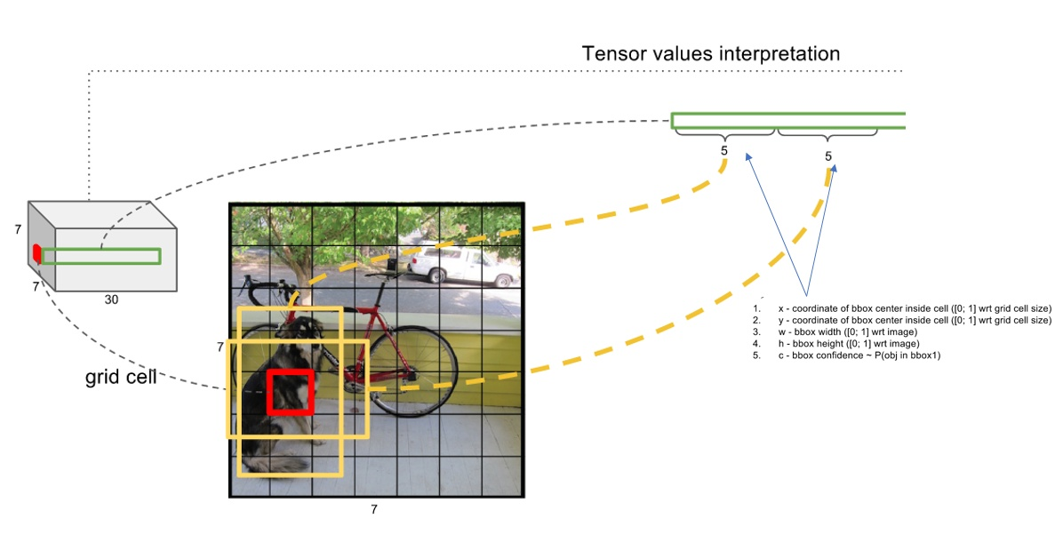
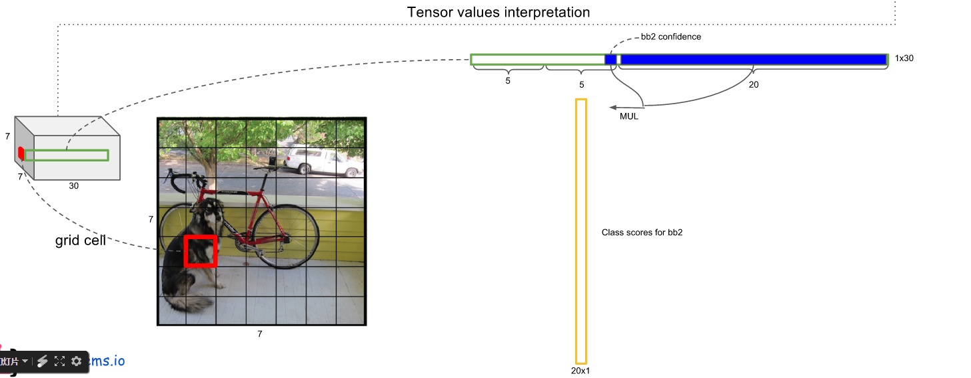
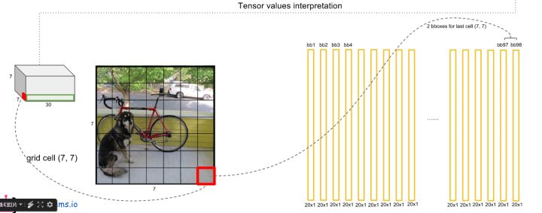
1. Pipeline
Unified Detection
Each bounding box consists of 5 predictions: x, y, w, h and confidence.
Each grid cell also predicts C conditional class probabilities, Pr(Classi|Object)
These predictions are encoded as an S*S*(B*5+C) tensor.
Notes:
The (x, y) coordinates represent the center of box relative to the bounds of the grid cell. The width and height are predicted relative to the whole image. The confidence prediction represents the IOU between the predicted box and any ground truth box.
S=7 B=2 C=20

Slide 8
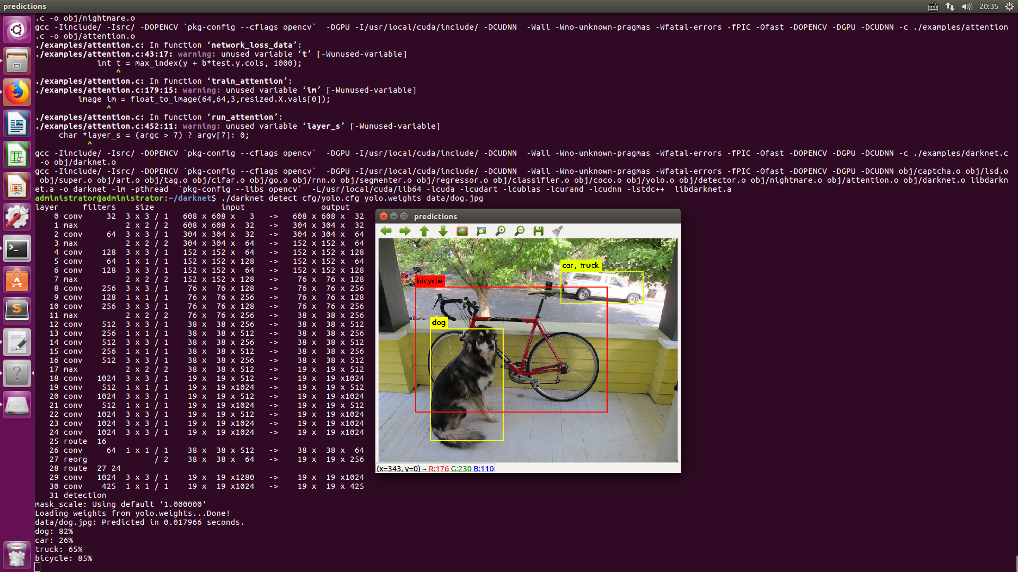
2. Experiments

Slide 9
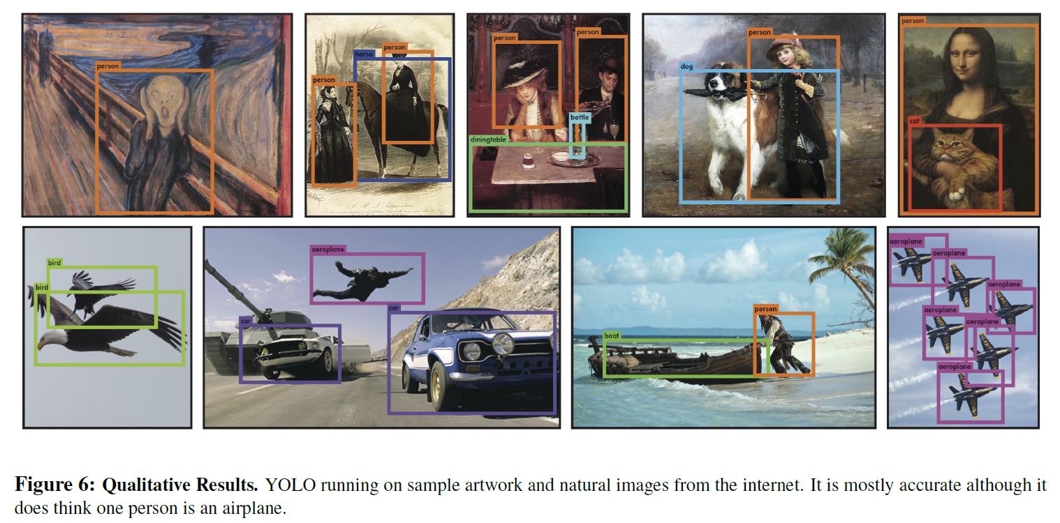
2. Experiments

Slide 10
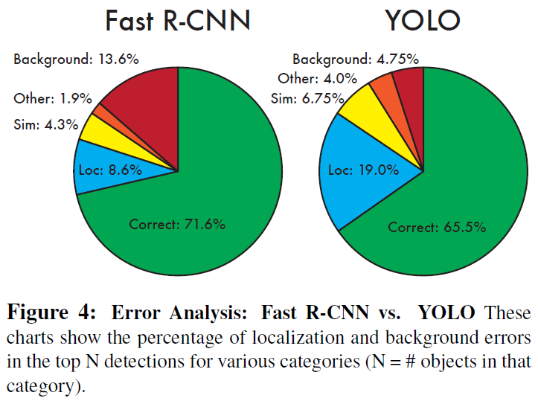
3. Comparison
Pros
YOLO is extremely fast.
YOLO reasons globally about the image when making predictions.
YOLO learns generalizable representations of objects.
Notes:
1. Since we frame detection as a regression problem we don’t need a complex pipeline. We simply run our neural network on a new image at test time to predict detections.
2. YOLO makes less than half the number of background errors compared to Fast R-CNN
3. Since YOLO is highly generalizable it is less likely to break down when applied to new domains or unexpected inputs.

Slide 11
3. Comparison
Cons
YOLO lags behind state-of-the-art detection systems in accuracy.
It struggles to precisely localize some objects, especially small ones that appear in group, such as flocks of birds.
Notes:
1. Since we frame detection as a regression problem we don’t need a complex pipeline. We simply run our neural network on a new image at test time to predict detections.
2. YOLO makes less than half the number of background errors compared to Fast R-CNN
3. Since YOLO is highly generalizable it is less likely to break down when applied to new domains or unexpected inputs.

Slide 12
4. Summary
YOLO is an approach to object detection which is extremely fast, reasons globally about the images and learns generalizable representations. Even though it still lags behind other systems in accuracy and struggles to precisely localize some objects especially small ones, its well performing in real-time object detection makes it ideal for computer vision applications.
Notes:
1. Since we frame detection as a regression problem we don’t need a complex pipeline. We simply run our neural network on a new image at test time to predict detections.
2. YOLO makes less than half the number of background errors compared to Fast R-CNN
3. Since YOLO is highly generalizable it is less likely to break down when applied to new domains or unexpected inputs.

Slide 13
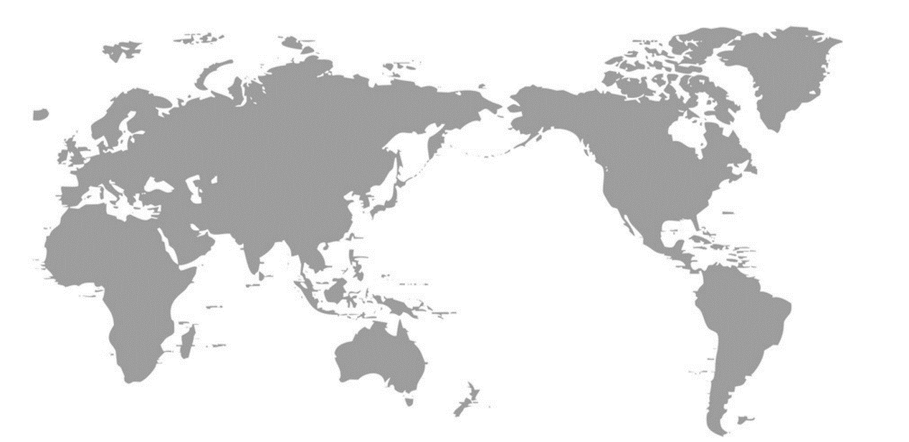


T | H | A | N | K |  | Y | O | U
Designed By Yang Dexing, Sichuan University,@四川大学杨德兴 欢迎使用

